Slide 1
Project Based Learning
No-34

Slide 2
Detecting Phishing website using data mining techniques

Slide 3
“Phishing is the simplest kind of cyberattack, and at the same time, the most dangerous and effective.”

Slide 4
What is Phishing?
Phishing attacks are the practice of sending fraudulent communications that appear to come from a reputable source.
It is usually done through email.
The goal is to steal sensitive data like credit card and login information, or to install malware on the victim's machine.

Slide 5
Phishing is a type of cybercrime in which a sender seems to come from a genuine organization like PayPal, eBay, financial institutions, or friends and co-workers.
They contact a target or targets via email, phone, or text message with a link to persuade them to click on that links. This link will redirect them to fraudulent websites to provide sensitive data such as personal information, banking and credit card information, social security numbers, usernames, and passwords.

Slide 6
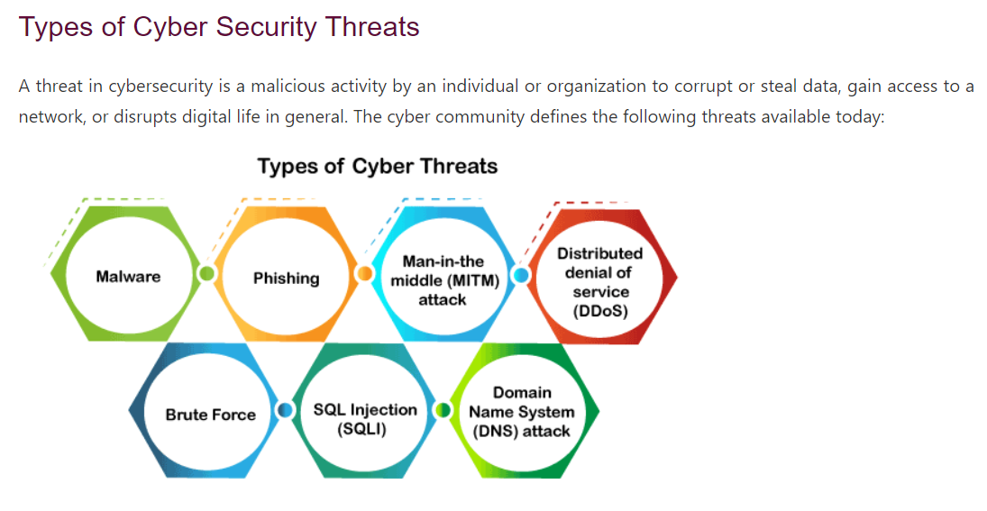

Slide 7
Types of phishing attacks
➔ Email phishing
--Business email compromise
--Clone phishing
--419/Nigerian scams
➔ Vishing (voice call phishing)
➔ Smishing (SMS or text message phishing)
➔ Catphishing
➔ Whale phishing
➔ Spear phishing

Slide 8
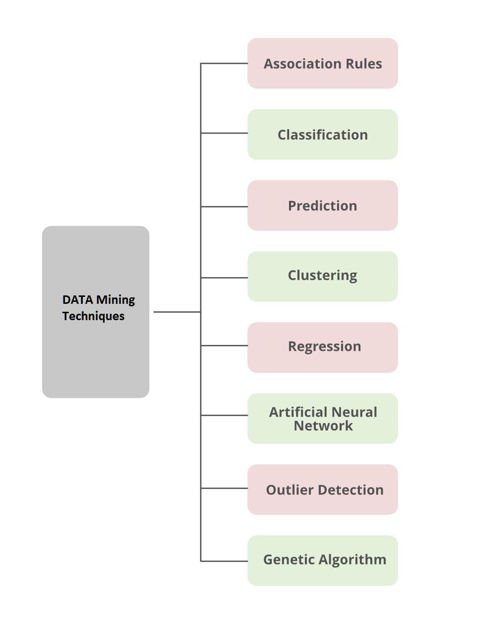

Slide 9
SYSTEM
System Module involves five steps.
1. Dataset collection : Text dataset of Phishing site details.
2. Pre-processing : In pre-processing step, separating data and label.
3. Feature Extraction : In feature extraction stage, the text features are extracted. The system cannot understand the text data so we convert the text data into numerical values.
4. Training : Here we train the machine learning Classifier. We use the random forest classifier to classify the entered site into phishing site or not.
5. Testing : In testing phase the classifier predict a new URL of website

Slide 10
ALGORITHM
We are using random forest classification. A Random Forest is an ensemble technique accomplished of performing both regression and classification tasks with the help of multiple decision trees and a technique called Bootstrap Aggregation, commonly known as bagging. The basic idea behind this is to integrate multiple decision trees in deciding the final output rather than relying on individual decision trees.
Logistic regression
Confusion matrix
Decision tree
randomforestclassifier

Slide 11
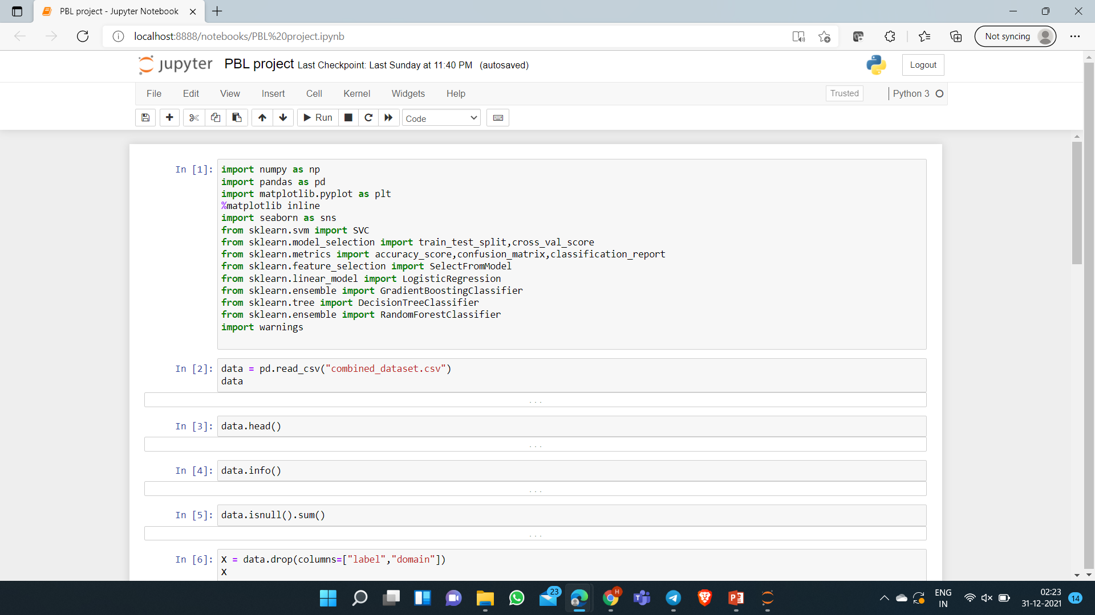

Slide 12
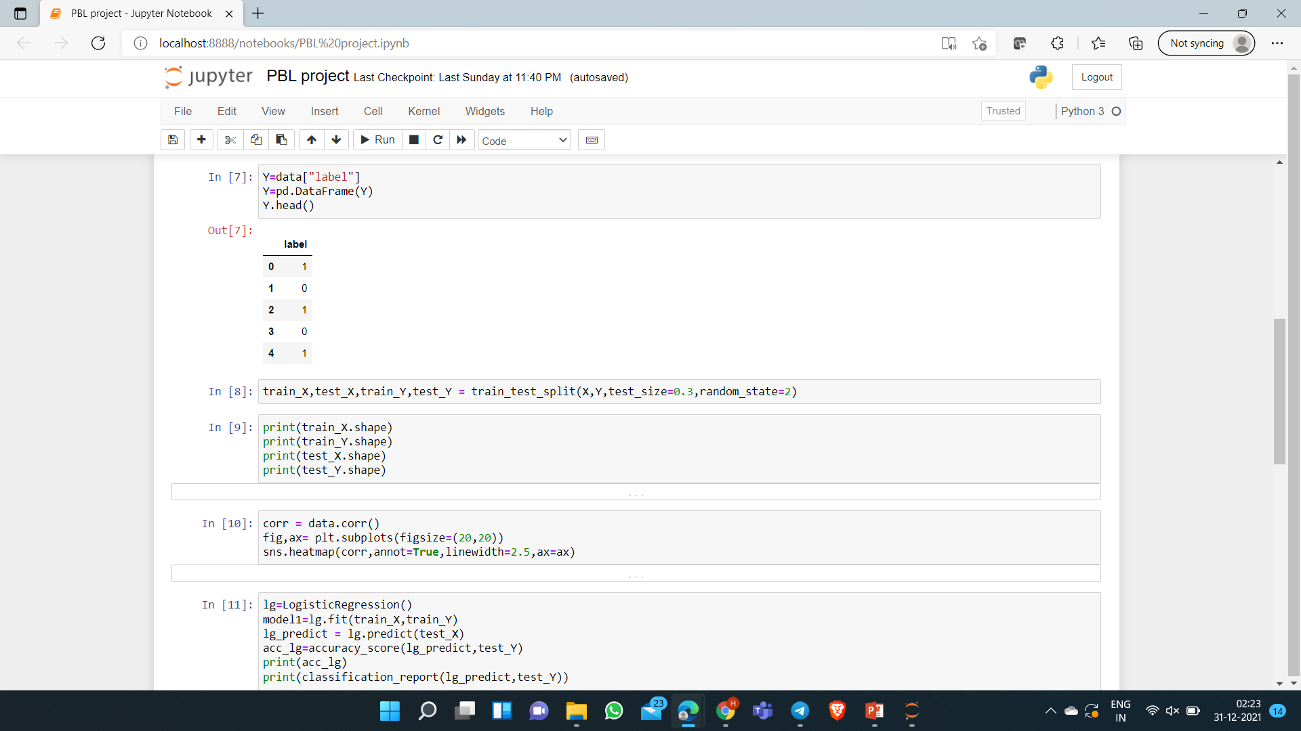

Slide 13
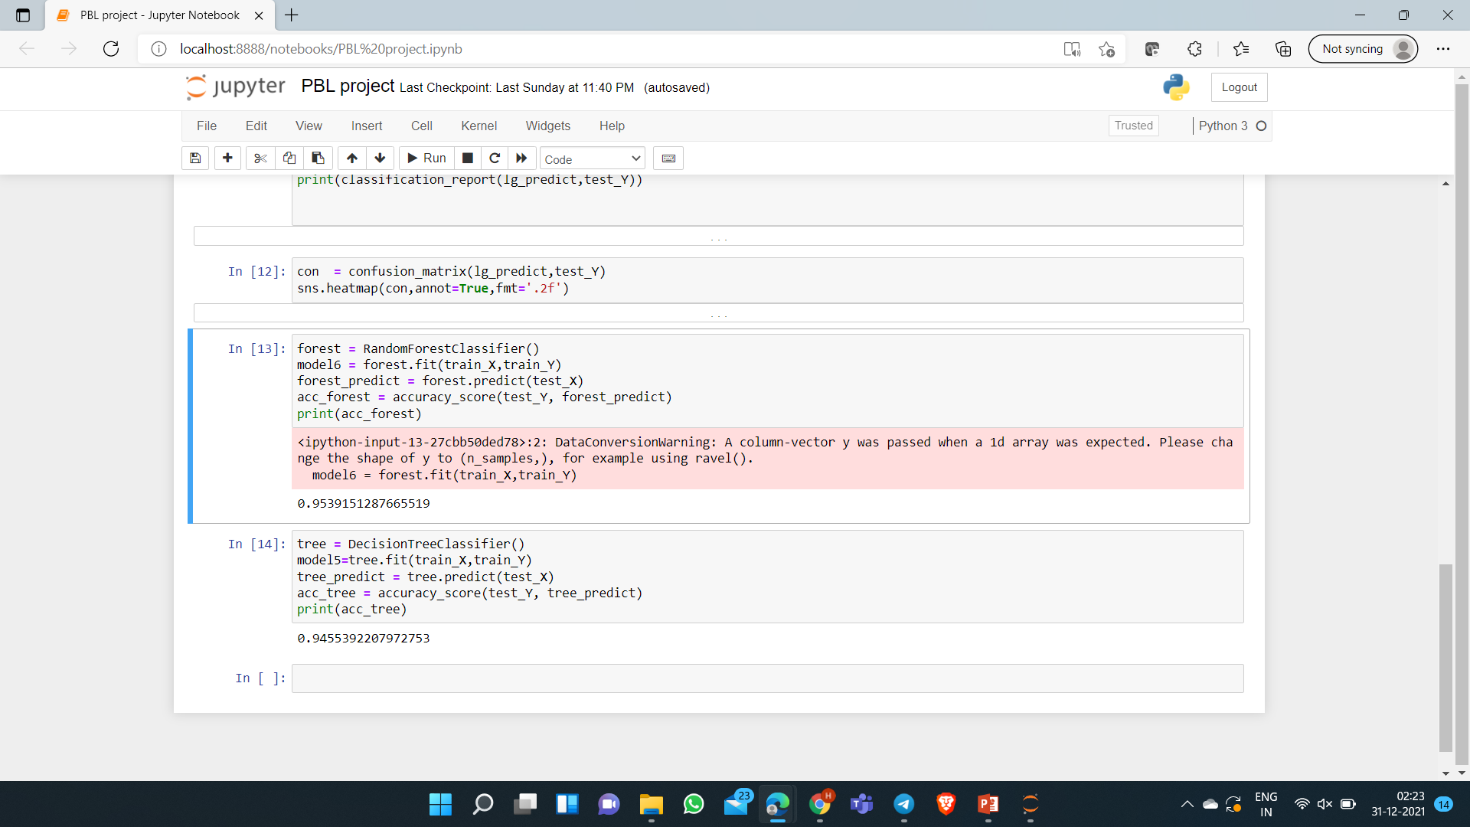

Slide 14
THANK YOU

